Slide 1
Explanation of the We-Energy Game Biomass version
Frank Pierie

Slide 2
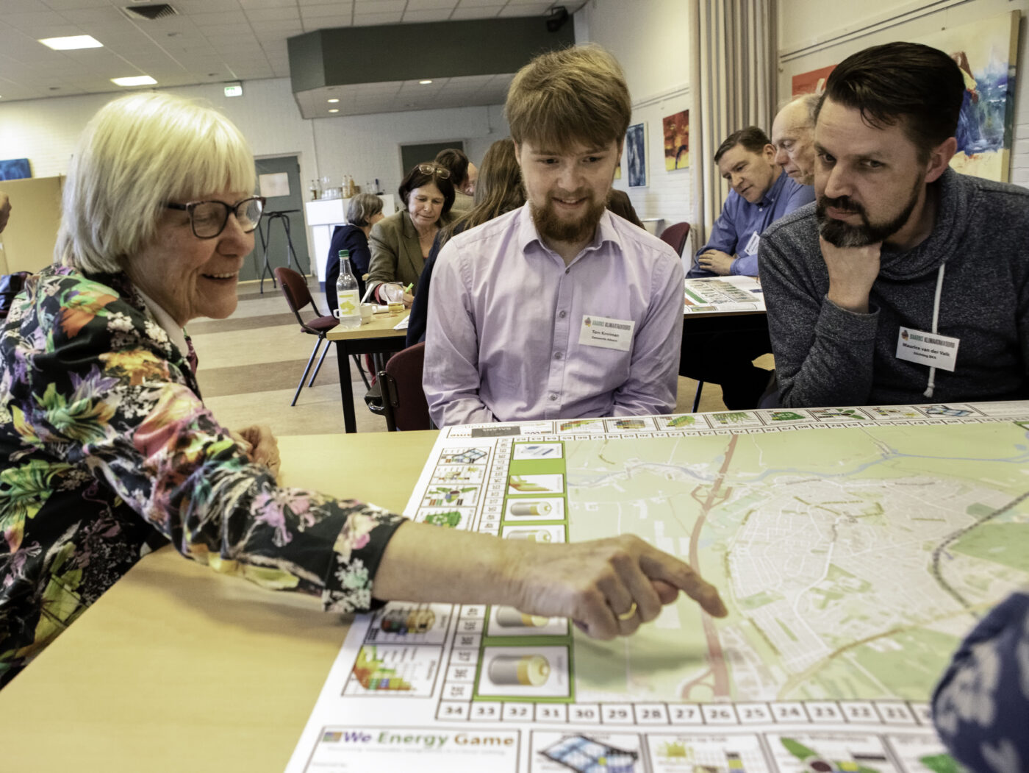
Doawnload the We-Energy Game
Download the game
www.entrance.eu

Slide 3
Starting with a question
So….. What could become the role of biomass and anaerobic digestion in the energy transition?

Slide 4
Goal of the game Turn a village or neighborhoods into a PED using Biogas
All roles must work together to achieve this PED
All roles must achieve their personal goal

Slide 5
Sub goals of the game
Step 1: Reach 100 energy points using biomass only
Step 1: Process the digestate cards and try to reach 0 nutrients points
Step 3: Evaluate and optimize the system till all the roles are happy
and Optimize the system for all roles

Slide 7
The different roles in the game
Energy / Chairperson
Nutrients / Farmer
People
Planet
Profit
Balance
Permits (optional)

Slide 8
YOUR GOAL
100 Points

Slide 9
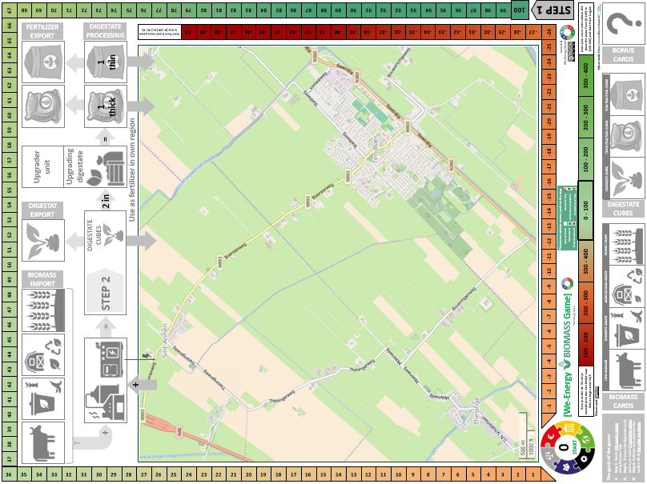
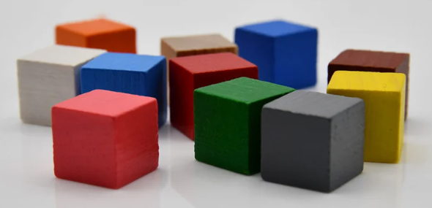
The technology cards
Bonus cards
The digestate cubes 3 colors
The different RE biomass cards
9

Slide 10
The game map
Processing of digestate for nutrient balance
Place biomass cards on the map
Import of biomass and the production of biogas to electricity

Slide 11
The biomass cards front
Every biomass cards represents a specific area required for the cultivation of the biomass
All biomass cards can be placed on the map, also including bonus cards.
500 meters
500 meters

Slide 12
Biomass cards back
Name of the technology
Short explanation of the technology
Requirements of the technology
Additional info
The color gives an indication of where the card can best be placed
White for agricultural area
Green for parks and forest
Red for the build environment

Slide 13
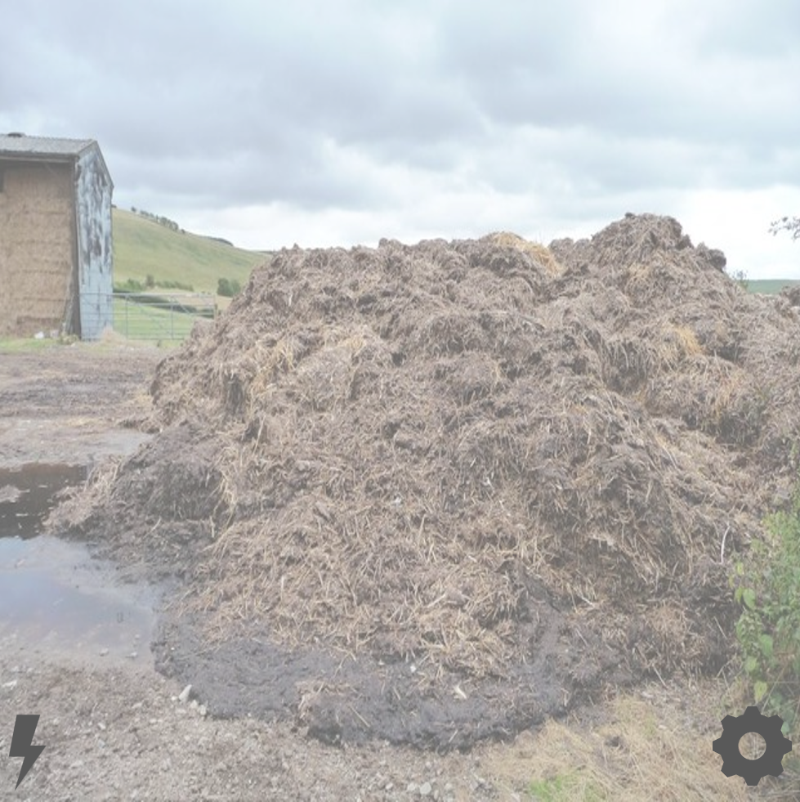
Example color indication
Manure can be easily placed on agricultural land
However not handy in build environment

Slide 14
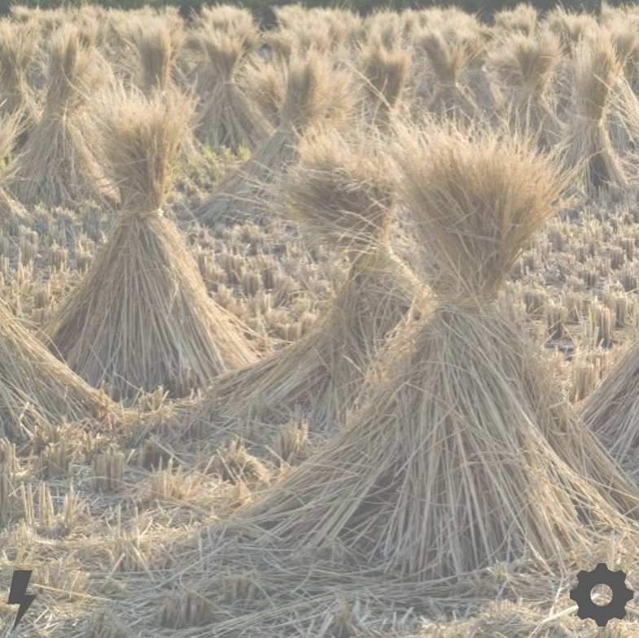
Biomass digestion energy production
Every biomass card must be combined with a manure card
+
For every biomass card one digestate cube must be places in storage (also import)

Slide 15
The meaning of the icons used
Goal score are the points all roles must reach
A card with this icon works with electricity
A card with this icon works with heat
A card with this icon produces energy
A card with this icon stores energy
A card with this icon reduces energy
A card with this icon has a requirement
A card with this icon has a benefit

Slide 16
The bonus cards
Place for the bonus cards
16

Slide 17
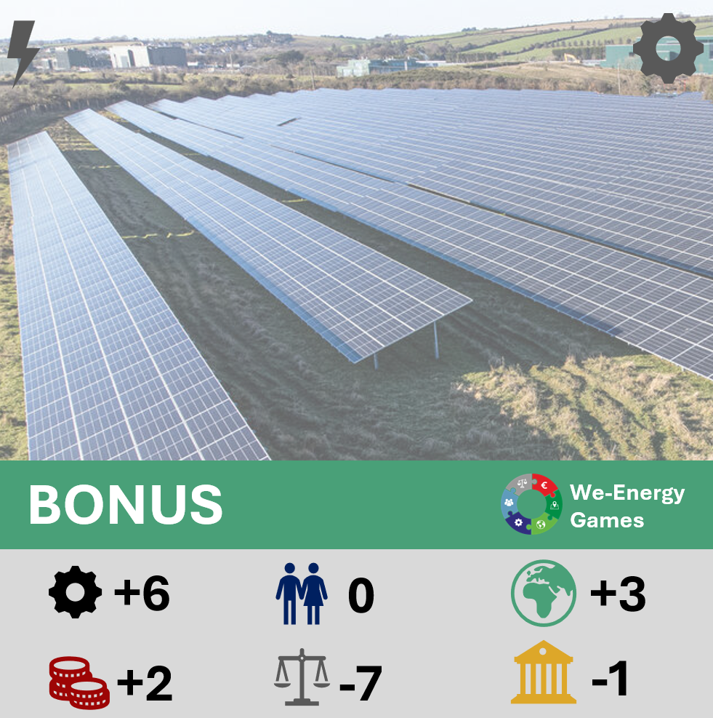
Examples bonus card
Points received for this bonus card and possible requirements

Slide 18
Examples bonus card
Name of bonus card
Info bonus card
Scan the QR for more info!!

Slide 19
How do you count your score?
Use this when you have more that 100 points or les than -50
Score counter per role
Place your role pawn here at start!

Slide 20
Example round
Let's play a short round

Slide 21
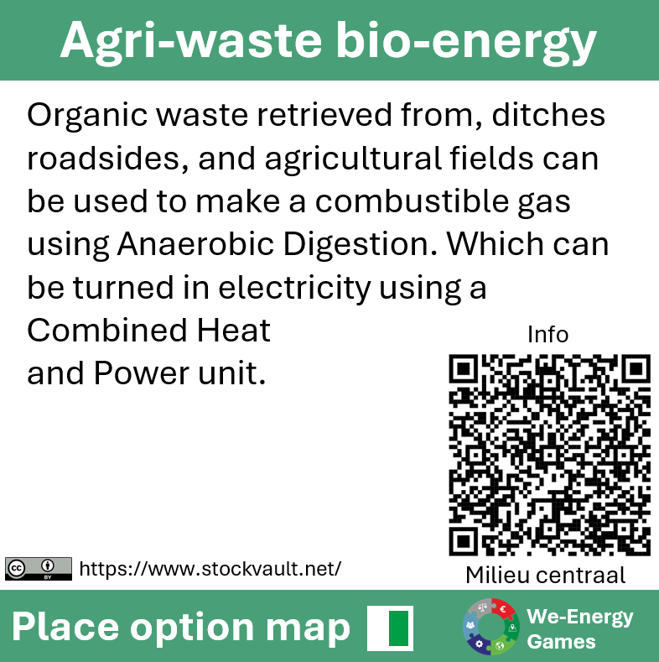
Example round?
As energy / chairman I place an Agri-waste biomass card and a manure card
21

Slide 22
Role cards ENERGY / CHAIRMAN
Points received for placing Agri-waste and manure

Slide 23
Moving your pawn
As chairman I receive 1 points for manure and 4 points for Agri-waste totaling 6 points
Place your pawn here

Slide 24
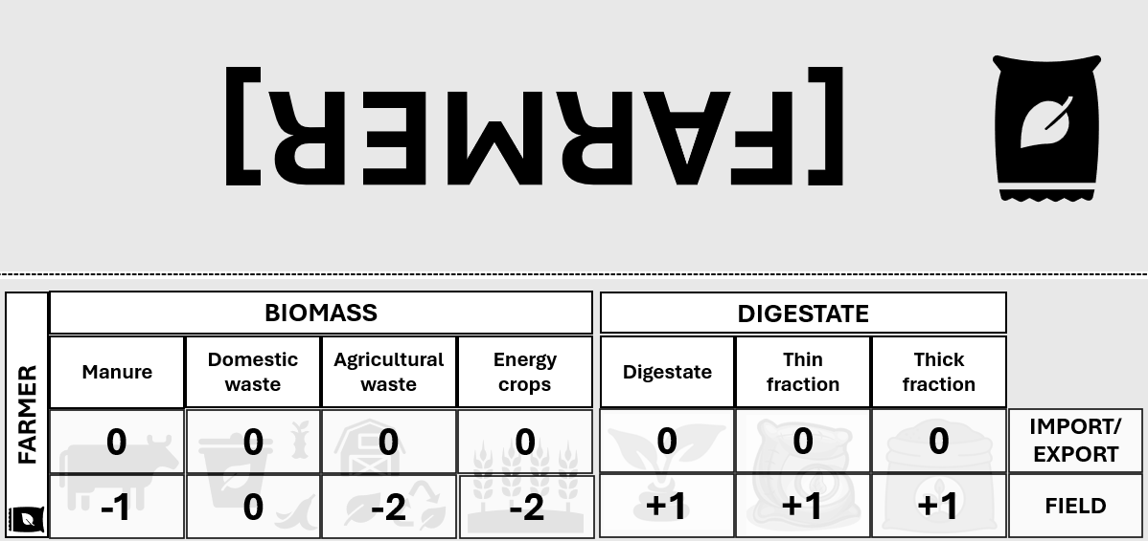
Role cards Nutrients / Farmer
Points received for placing Agri-waste and manure

Slide 25
Moving your pawn
However, as farmer receive -1 points for manure and -2 points for Agri waste totaling -3 pints
Place your pawn here

Slide 26
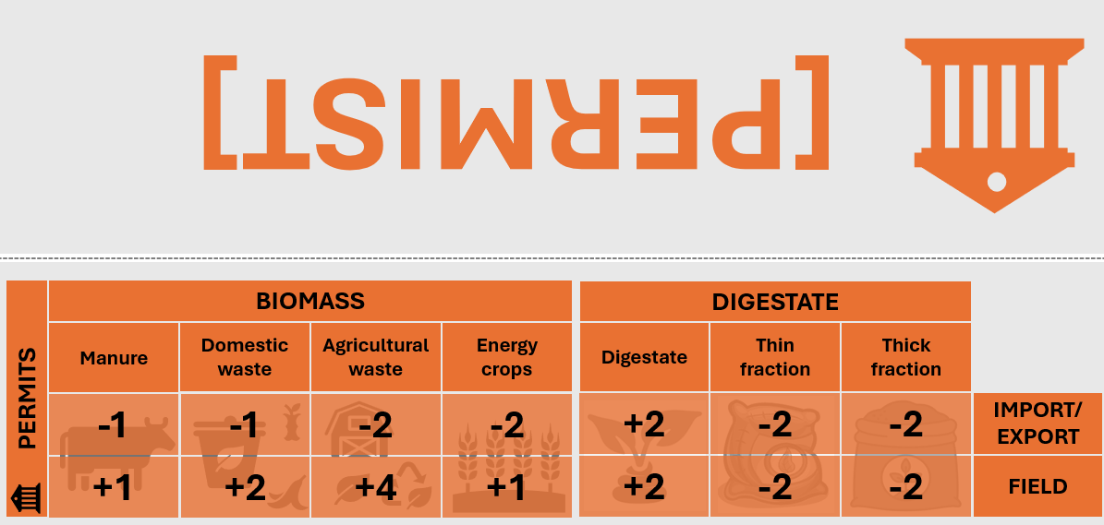
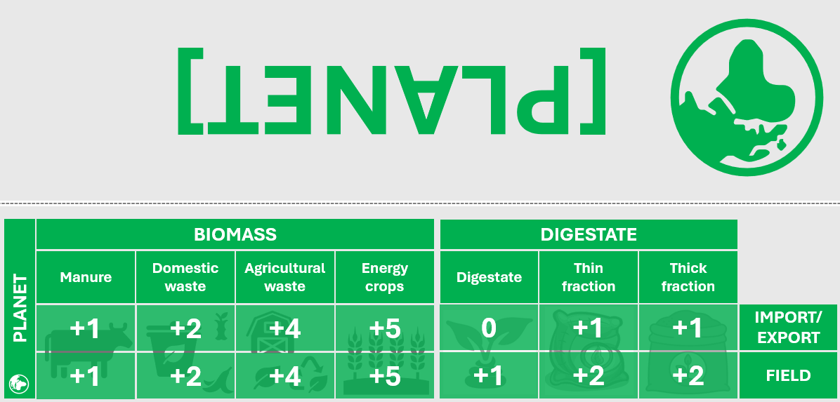
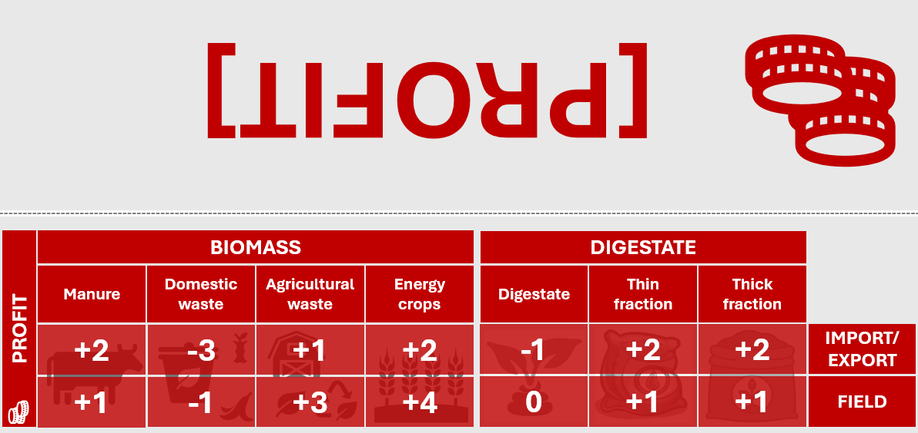
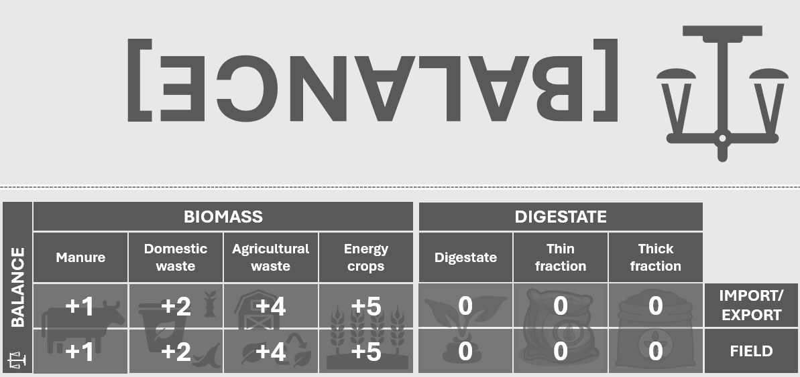
Looking at all the role cards

Slide 27
All the pawns start moving
FARMER
ENERGY
BALANCE
PERMITS
PLANET
PROFIT
PEOPLE??

Slide 28
PHASE TWO
PROCESSING THE DIGESTATE AND NUTRIENTS
Process all the
Then solve the PED together

Slide 29
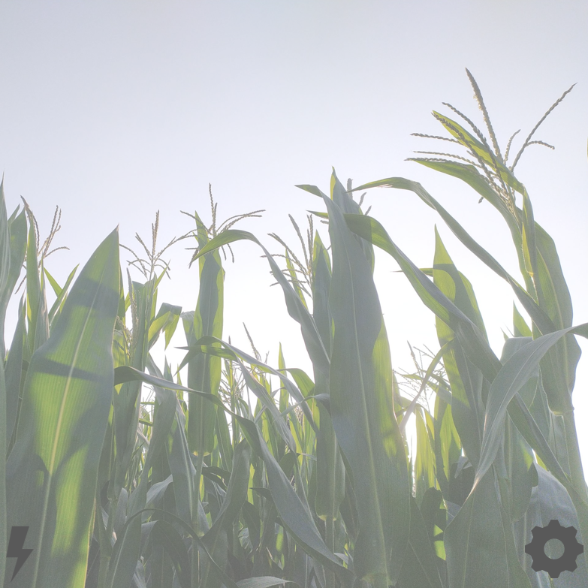
Amount of digestate cubes, an example
+ Map
5 Manure
5 maize
+ Import
5 Manure
5 maize
= Digestate
20 Digestate

Slide 30
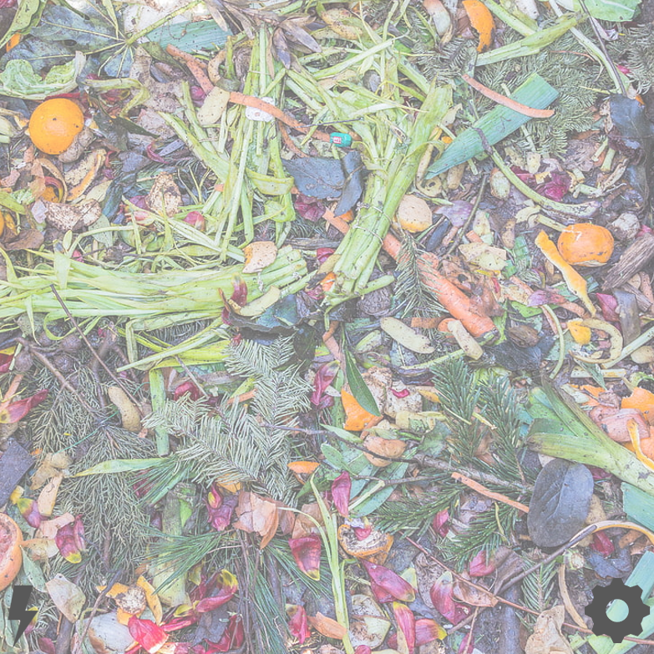
Fertilizing your land
Manure
1 Digestate cube
1 Thin fraction cube
Domestic waste
None
IMPORT
Energy crops
1 Digestate cube
1 Thick fraction cube
1 Thin fraction cube
Imported biomass
None
IMPORT
Harvest remains
1 Digestate cube
1 Thick fraction cube
1 Thin fraction cube

Slide 31
Processing the digestate
Sell digestate
Use digestate as fertilizer
Buy an upgrader unit
Sell thick and thin as fertilizer
Use thick and thin as fertilizer
31

Slide 32
Playing the game
To achieve the common goal collaboration might be handy!

Slide 33
LET’S START
REMEMBER 100 POINT TO REACH A PED
FIRST ROUND 100 ENERY POINTS
THEN PROCES DIGESTATE AND GET NUTRIENTS ON ZERO

Slide 34
CONTACT
Dr. Ing. Frank Pierie
Senior researcher | Lecturer | Hanze University of Applied Sciences | Hanze Research Centre - Energy | EnTranCe | Mail address: Hanze University of applied science, P.O. box 3037, 9701 DA Groningen, The Netherlands |Visiting address: Nijenborgh 6, 9747 AG Groningen| T: +31 (0)50 595 4640 |M: +31 (0)6 510 67 674 | E: f.pierie@pl.hanze.nl

