Slide 1
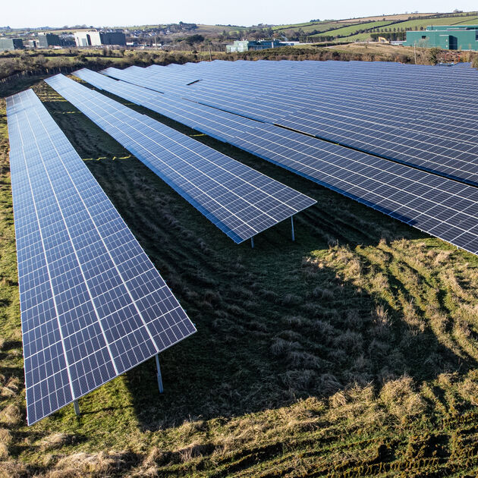
We-Energy
Games
BONUS
+6
0
+3
+2
-7
-1

Slide 2
SOLAR PV PARK
Electricity can be extracted from the sun directly using solar PV panels, which can be placed in fields.
Info
https://www.echolive.ie/
Milieu centraal
Place option map
We-Energy
Games

Slide 3
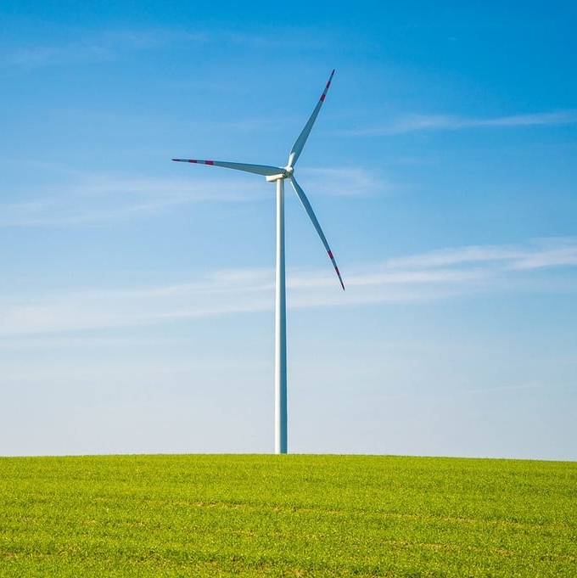
We-Energy
Games
BONUS
+5
-6
+6
+3
-3
-4

Slide 4
LARGE WIND TURBINES
Large wind turbines can be placed on available land and are around 100 meters high with a capacity of 2 MW
Info
https://www.shutterstock.com/
Milieu centraal
Place option map
Place option map
We-Energy
Games

Slide 5
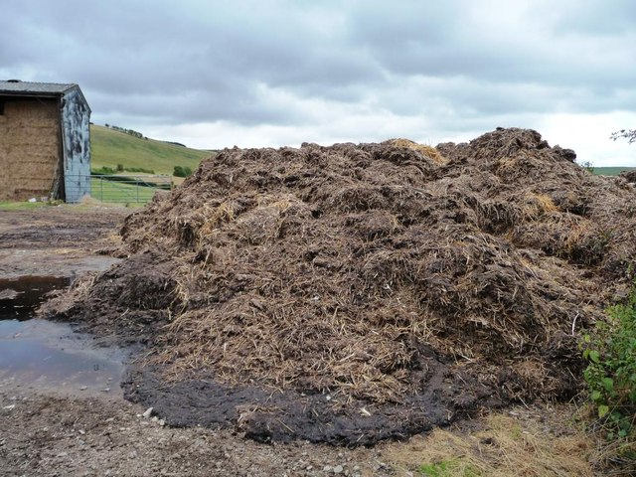

Slide 6
POWER – MANURE
Manure is produced by farm animals. Which can be turned in electricity using a Combined Heat and Power unit.
Info
https://www.geograph.org.uk/
Milieu centraal
Place option map
We-Energy
Games

Slide 7
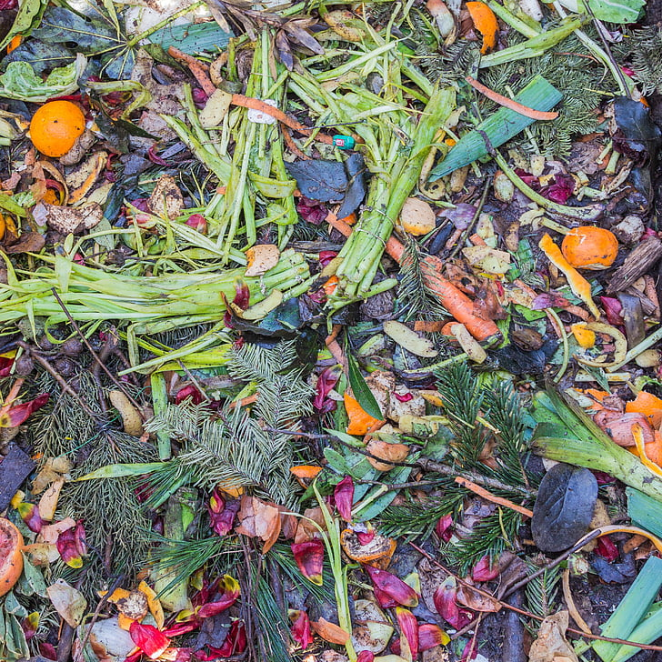

Slide 8
POWER - KITCHEN WASTE
Organic waste can be retrieved from households to make biogas using Anaerobic digestion. Which can be turned in electricity using a Combined Heat and Power unit.
Info
https://www.orc.govt.nz
Milieu centraal
Place option map
We-Energy
Games

Slide 9
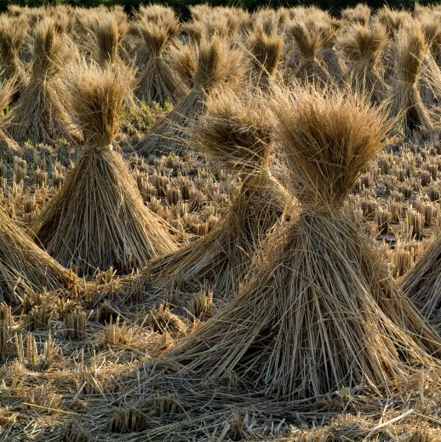

Slide 10
POWER – AGRI WASTE
Organic waste retrieved from, ditches roadsides, and agricultural fields can be used to make a combustible gas using Anaerobic Digestion. Which can be turned in electricity using a Combined Heat and Power unit.
Info
https://www.stockvault.net/
Milieu centraal
Place option map
We-Energy
Games

Slide 11
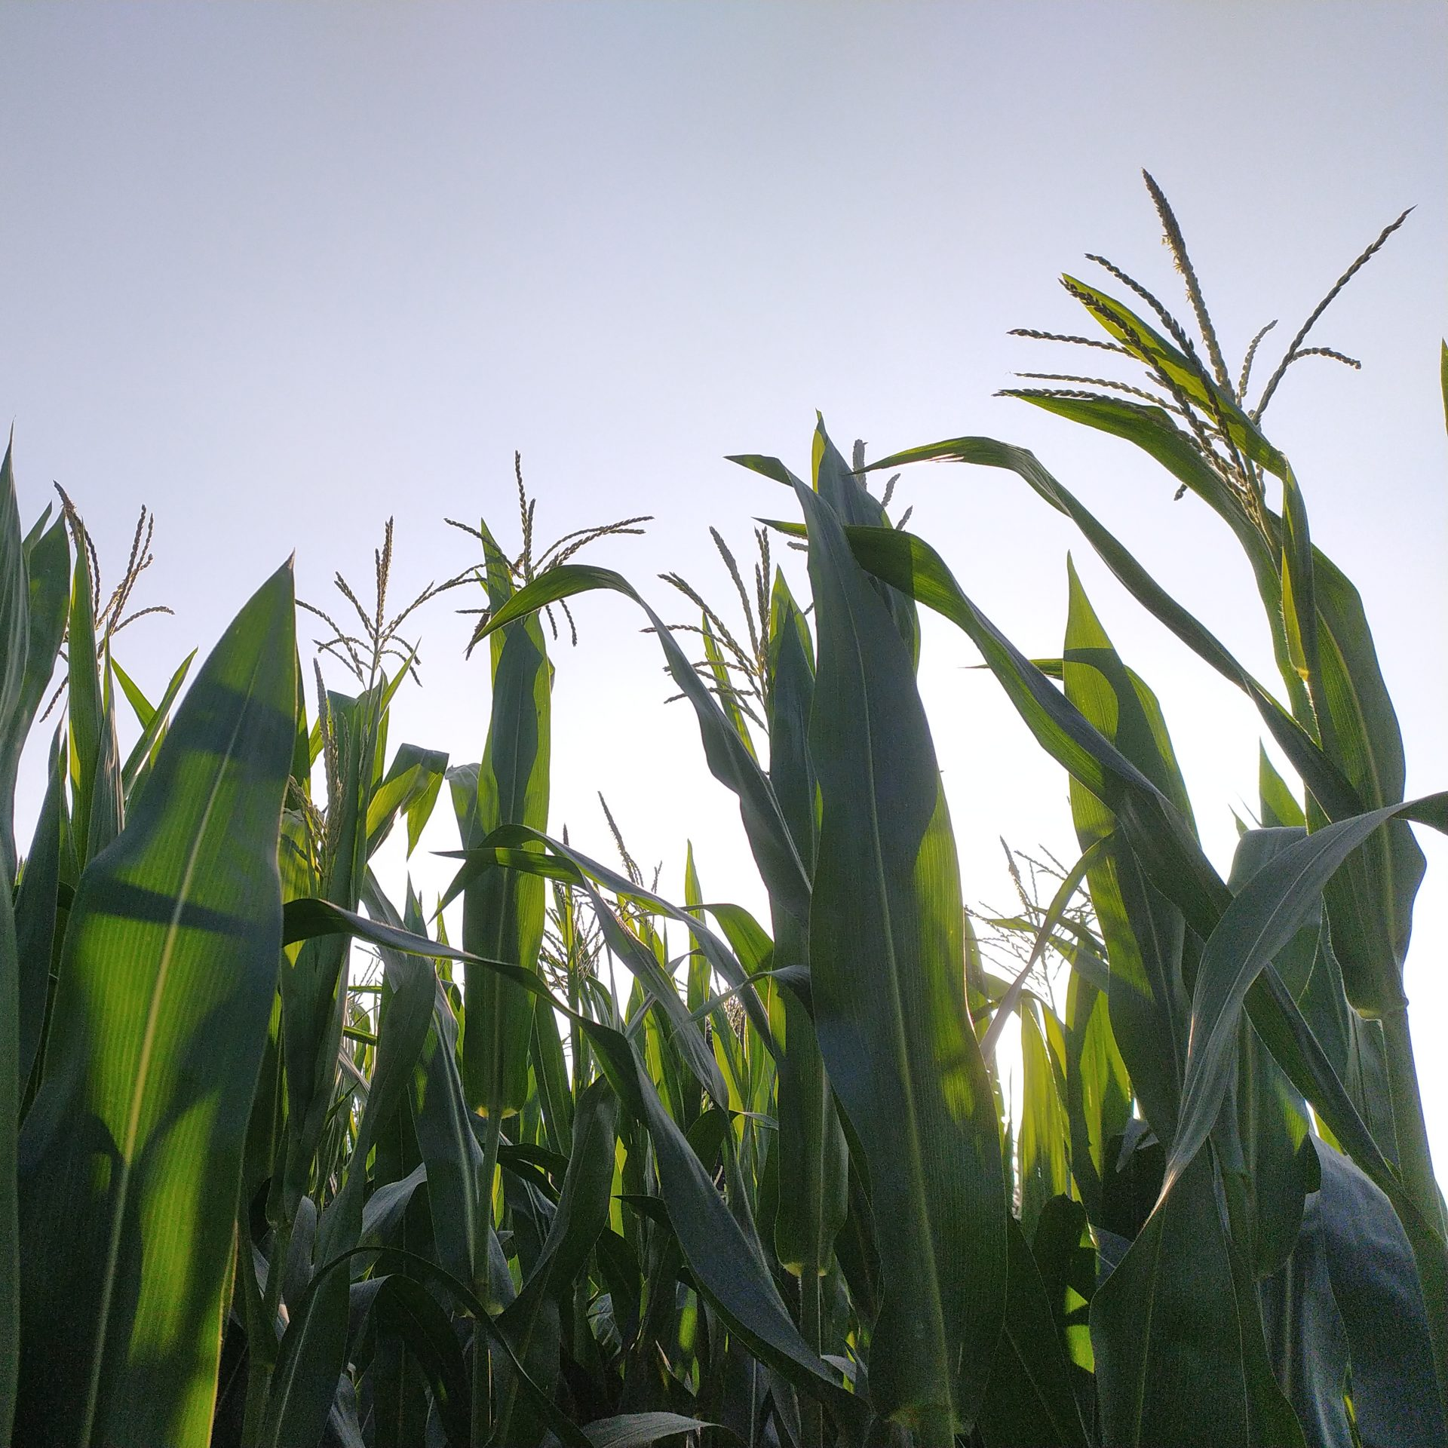

Slide 12
POWER – ENERGY CROPS
Energy crops cultivated on agricultural fields can be used to make a combustible gas using Anaerobic Digestion. Which can be turned in electricity using a Combined Heat and Power unit.
Info
https://pixahive.com/
Milieu centraal
Place option map
We-Energy
Games

