Slide 1
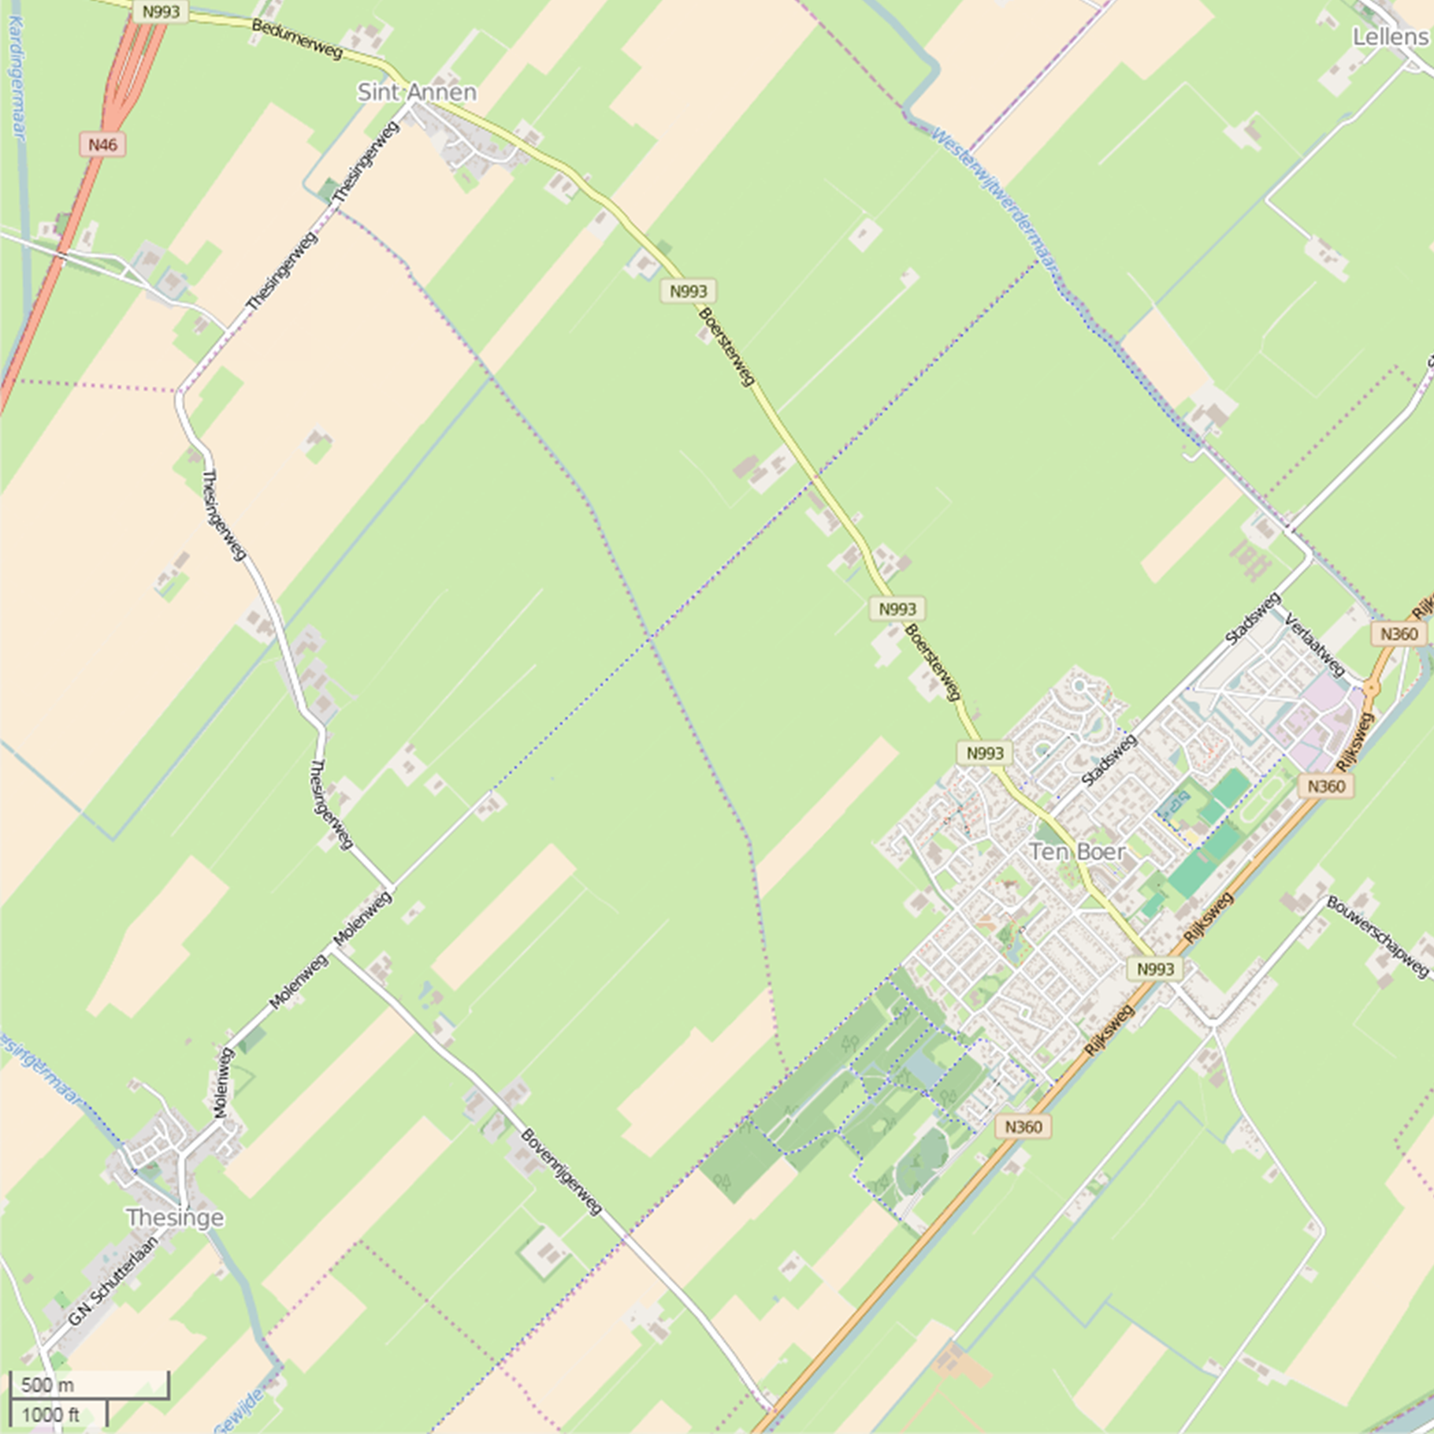
We-Energy / ADAPNER – Biomass game
36
37
38
39
40
41
42
43
44
45
46
47
48
49
50
51
52
53
54
55
56
57
58
59
60
61
62
63
64
65
66
67
35
Upgrader
unit
68
34
69
33
BIOMASS IMPORT
DIGESTAT EXPORT
FERTILIZER EXPORT
70
32
Upgrading digestate
71
31
DIGESTATE CUBES
72
30
1 thick
1 thin
73
+
=
STEP 2
2 in
=
DIGESTATE PROCESSING
29
74
28
+
Use as fertilizer in own region
75
27
+
76
26
Start from 0 and move pawn in box [0-100] to [-50 - 0]
77
25
78
24
PLACE FOR MAP
-50
79
23
-49
80
22
-48
81
21
-47
82
20
-46
83
19
-45
84
18
-44
85
17
-43
86
16
-42
87
15
-41
88
14
-40
89
13
-39
90
12
-38
91
11
-37
92
10
-36
92
9
-35
93
8
-34
94
7
PLACE FOR MAP
-33
95
6
-32
96
5
-31
97
4
-30
98
3
-29
99
2
-28
100
1
https://www.openstreetmap.org/
-27
0
-1
-2
-3
-4
-5
-6
-7
-8
-9
-10
-11
-12
-13
-14
-15
-16
-17
-18
-19
-20
-21
-22
-23
-24
-25
-26
STEP 1
[We-Energy BIOMASS Game]
Placement options source cards on the map
Level 1-2
We-Energy Game
Open farmland
Not on the map
START
® We-Energy Game
Nature/parks
Farmland or park/nature
Kom je onder de -50 zet je tweede pion dan een blokje naar links en begin weer bij 0
100 - 200
200 - 300
300 - 400
Build environment
All locations on map
0 - 100
100 - 200
200 - 300
300 - 400
Does your score come above 100 place the pawn from [0-100] to [100-200] and start from 0 again
The goals of the game:
Step 1: Reach 100 energy points using biomass only
Step 1: Process the digestate cards and try to reach 0 nutrients points
Step 3: Evaluate and optimize the system till all the roles are happy
Pictures used:
COW MANURE
DOMESTIC WASTE
AGRICULTURAL WASTE
ENERGY CROPS
DIGESTATE CUBES
THICK FRACTION CUBES
THIN FRACTION CUBES
Info on cards: https://www.milieucentraal.nl/
BIOMASS CARDS
DIGESTATE CUBES
BONUS CARDS

