Slide 1
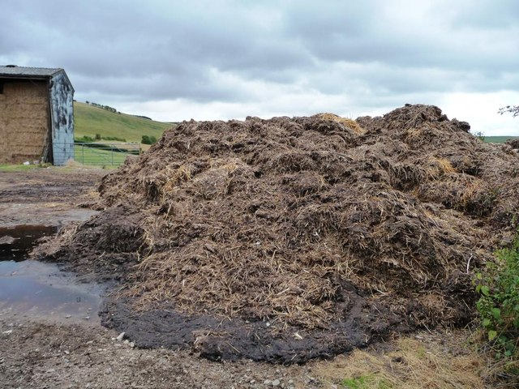

Slide 2
Manure
Manure is produced by farm animals. Which can be turned in electricity using a Combined Heat and Power unit.
Info
https://www.geograph.org.uk/
Milieu centraal
Place option map
We-Energy
Games

Slide 3
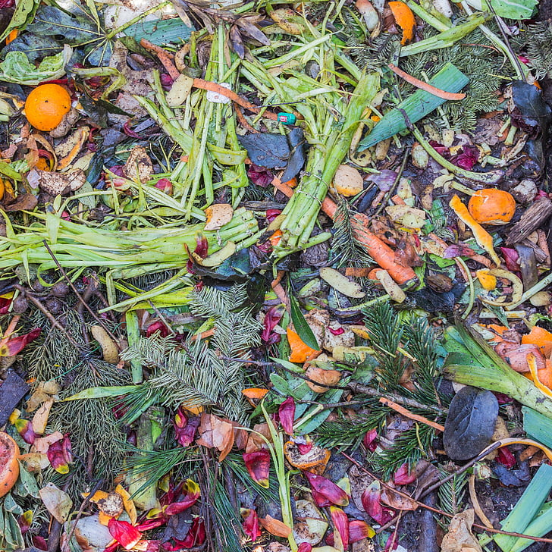

Slide 4
Home bio-energy
Organic waste can be retrieved from households to make biogas using Anaerobic digestion. Which can be turned in electricity using a Combined Heat and Power unit.
Info
https://www.orc.govt.nz
Milieu centraal
Place option map
We-Energy
Games

Slide 5
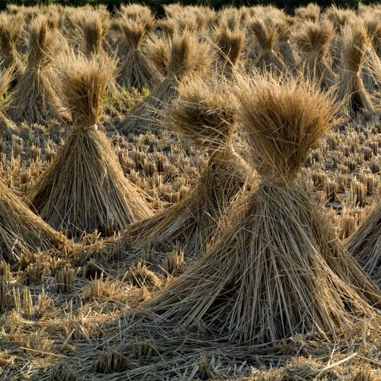

Slide 6
Agri-waste bio-energy
Organic waste retrieved from, ditches roadsides, and agricultural fields can be used to make a combustible gas using Anaerobic Digestion. Which can be turned in electricity using a Combined Heat and Power unit.
Info
https://www.stockvault.net/
Milieu centraal
Place option map
We-Energy
Games

Slide 7
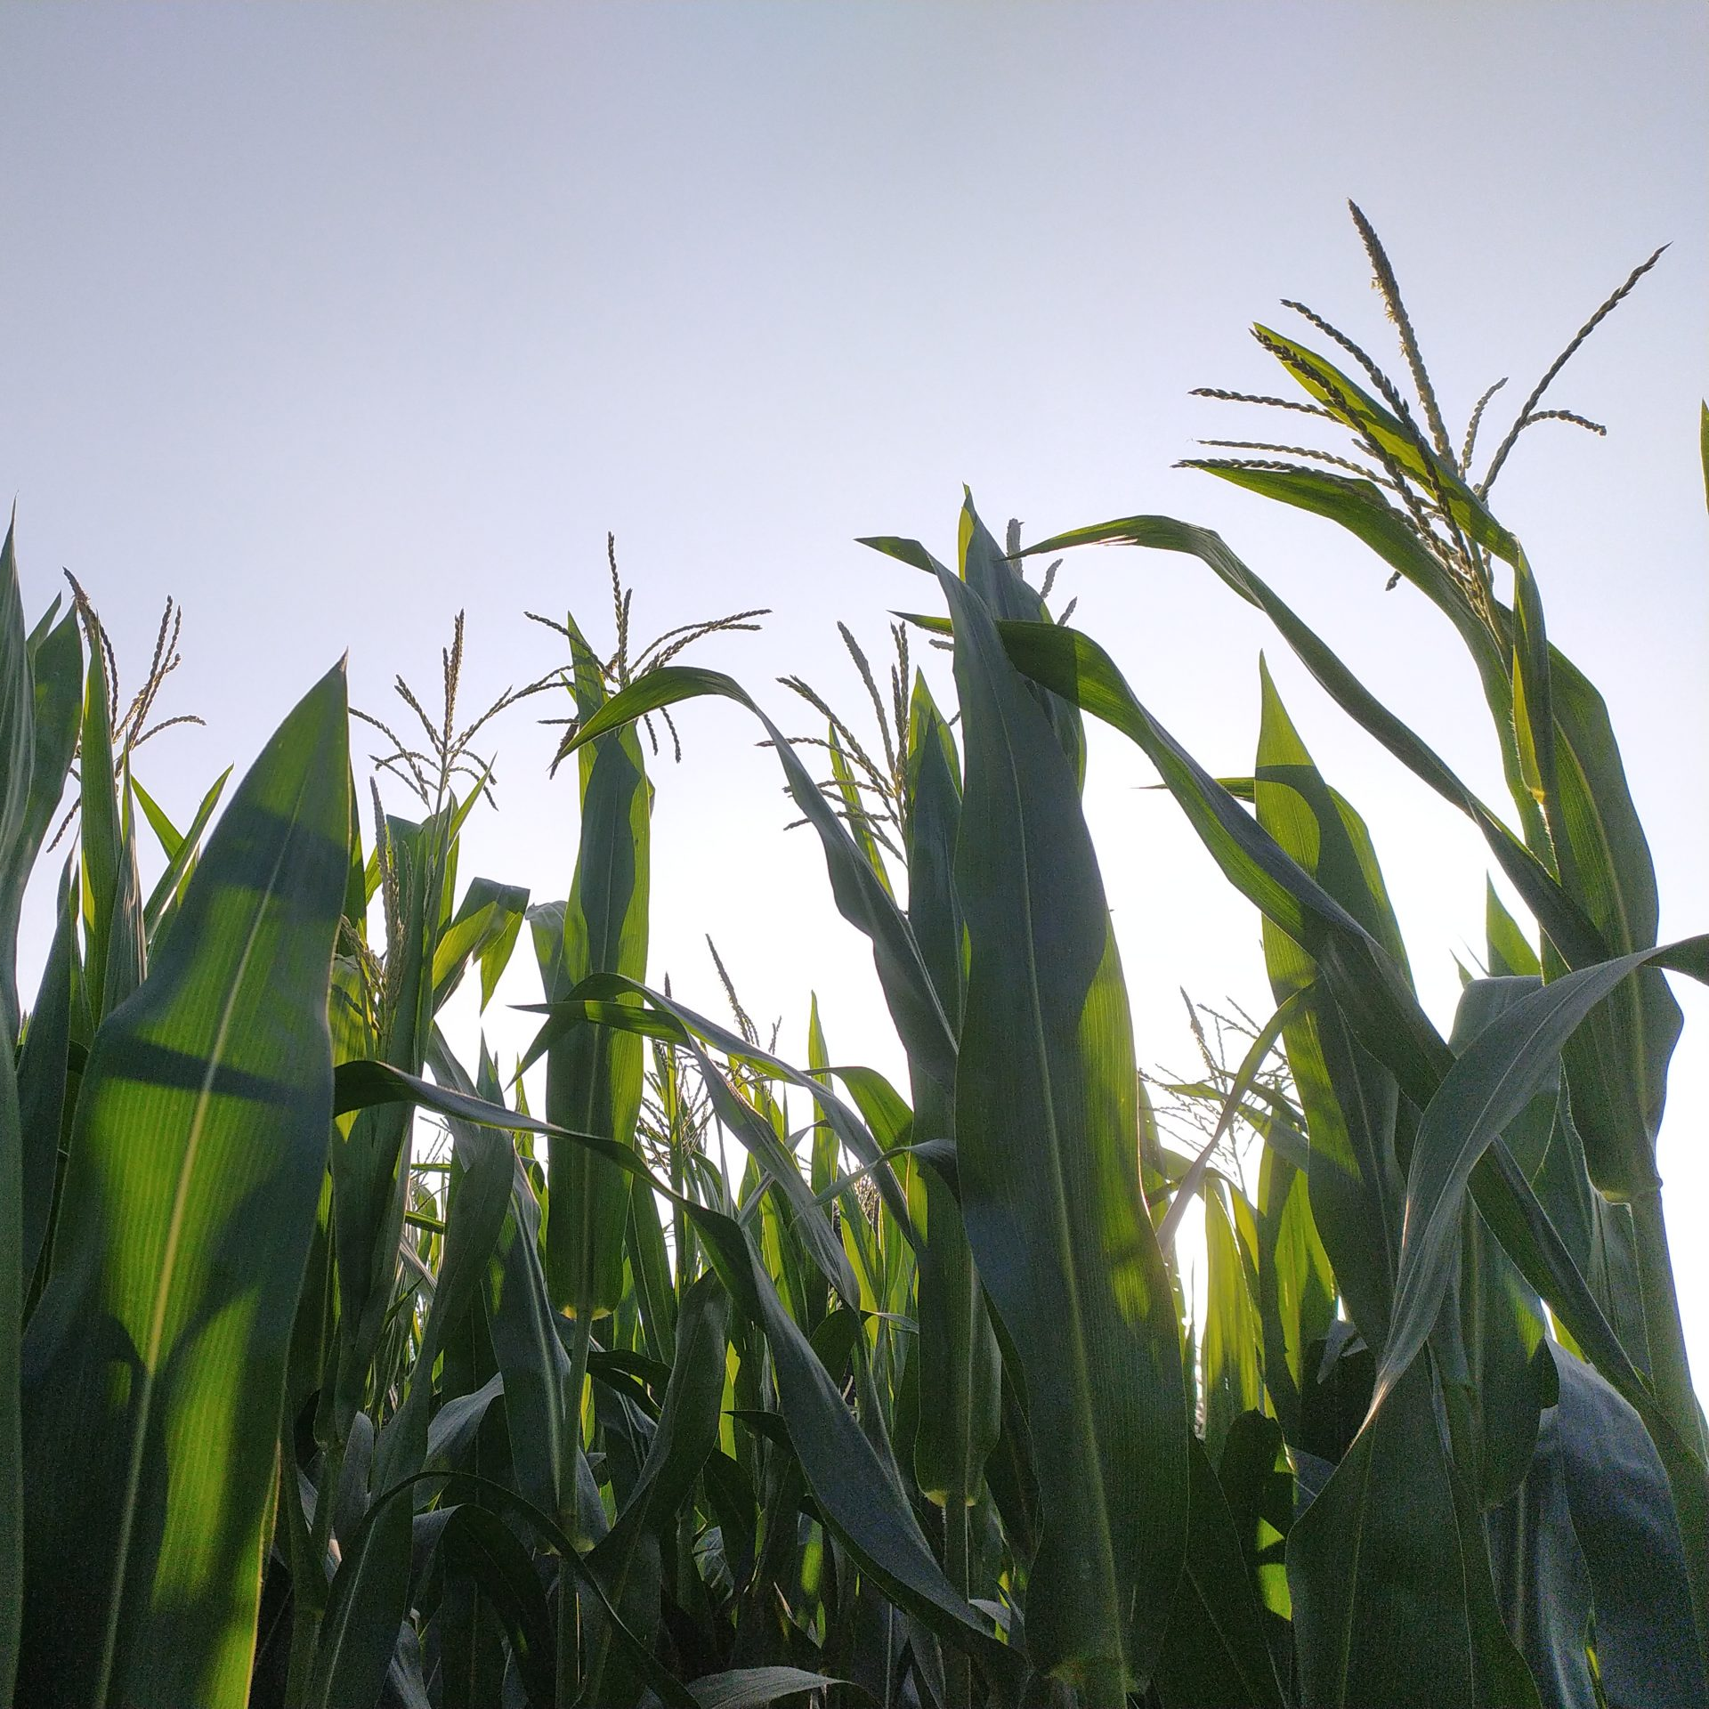

Slide 8
Cultivated bio-energy
Energy crops cultivated on agricultural fields can be used to make a combustible gas using Anaerobic Digestion. Which can be turned in electricity using a Combined Heat and Power unit.
Info
https://pixahive.com/
Milieu centraal
Place option map
We-Energy
Games

